Slide 1
WebApp With Docker EC2

Slide 2
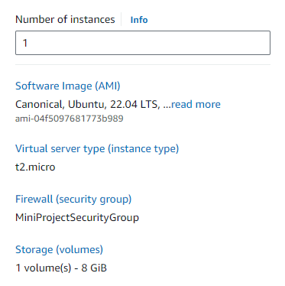
EC2

Slide 3
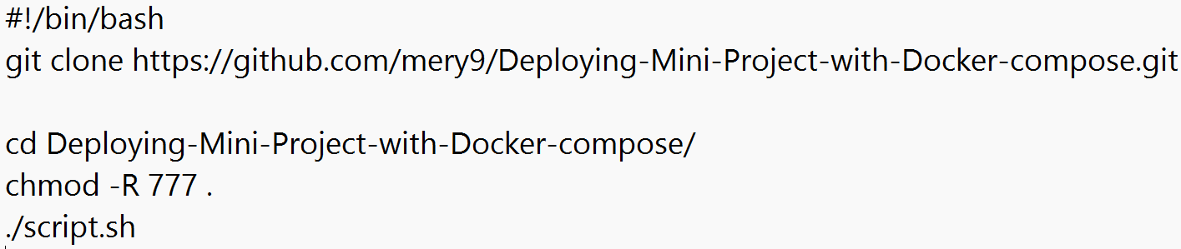
User data (startup run command)

Slide 4
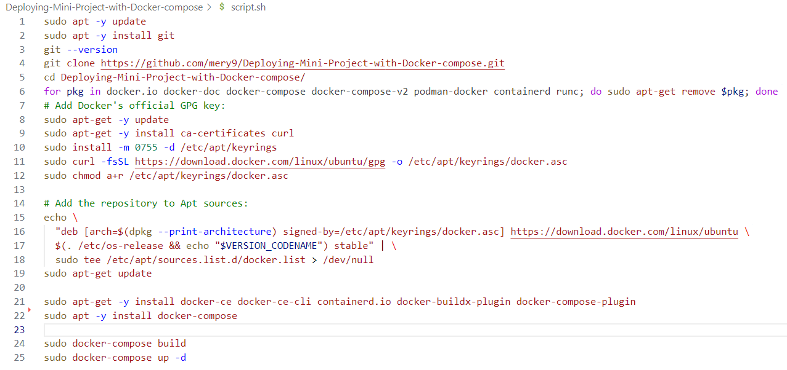
Script Automation

Slide 5
2 minutes 30 second Average Startup time

Slide 6
